Slide 1
Krakow, Summer 2011
Comparability Graphs
William T. Trotter
trotter@math.gatech.edu

Slide 2
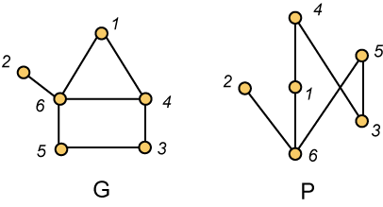
Comparability Graphs
A graph G is a comparability graph when there is a partial order P on the same ground set so that xy is an edge in G if and only if x and y are comparable in P, i.e., either x < y in P or y < x in P.

Slide 3
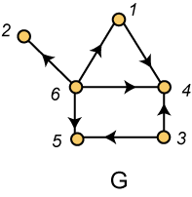
Transitive Orientations
Alternatively, a graph G is a comparability graph if G can be transitively oriented.

Slide 4
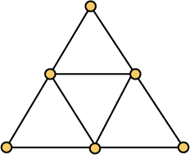
Forbidden Graphs
Exercise Evidently, if G is a comparability graph, then so is every induced subgraph of G. However, the graph shown below is not a comparability graph. However, delete any vertex and the remaining graph is then a comparability graph.

Slide 5
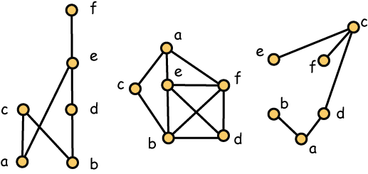
Incomparability Graphs
Definition A graph G is called an incomparability graph when it is the complement of a comparability graph. Here we show on the left a poset P, while its comparability graph is in the middle and its incomparability graph is on the right.

Slide 6
Natural Question
Question We learned (although the proof was not given) that it is NP-complete to determine whether a graph is a cover graph. On the other hand, it is natural to ask to hard it is to determine whether a graph is a comparability graph. In this case, we will see that there is a polynomial time algorithm that will provide the answer.

Slide 7
Comparability Testing Graphs
Definition With a graph G, we associate a comparability testing graph CT(G) whose vertices are the ordered pairs of adjacent vertices of G, i.e., for every edge e = xy in G, we have both (x, y) and (y, x) as vertices in CT(G). The edges of CT(G) correspond to induced paths on three vertices in G. When x, y and z are distinct vertices which induce a path with x not adjacent to z, we make (x, y) adjacent to (z, y) in CT(G). At the same time, we make (y, x) adjacent to (z, y).

Slide 8
Gallai’s Classic Theorem
Theorem (Gallai) A graph G is a comparability graph if and only if there is no edge e = xy in G for which both (x, y) and (y, x) belong to the same component of the comparability testing graph CT(G).
Remark It follows that the question: Is G a comparability graph can be answered in time O(n⁴) where n is the number of vertices in G.

Slide 9
Partitive Subsets
Definition A subset S of vertices in a graph G is partitive if for every vertex x which does not belong to S, either (1) x is adjacent to every vertex of S, or (2) x is adjacent to no vertices in S. A singleton set is always partitive, as is the set V of all vertices in G. Any other partitive set is non-trivial.
Corollary If P and Q are two partial orders in the same ground set and they yield the same comparablity graph, then there is a sequence P = P₀,P₁,…,P_{t} = Q, where P_{i+1} is obtained from P_{i} by inverting a partitive set.

Slide 10
Comparability Invariants
Definition A poset parameter, such as width, height and dimension, is a comparability invariant if any two posets with the same comparability graph have the same value. Trivially, height and width are comparability invariants. Non-trivial examples include dimension and number of linear extensions. In these last two cases, the conclusion follows immediately from Gallai’s structural characterization of partial orders with the same comparability graph.
Exercise Show that the number of edges in the cover graph is not a comparability invariant.

Slide 11
Testing dim(P) ≤ 2
Fact A poset P satisfies dim(P) ≤ 2 if and only if its incomparability graph is a comparability graph.
Fact Testing a graph on n vertices to determine whether it is a comparability graph can be done in O(n⁴) time.

Slide 12
Gallai’s List of Forbidden Graphs
Remark It follows from our preceding observations that there is some minimum list C of graphs so that a graph G is a comparability graph if and only if it does not contain an induced subgraph which is isomorphic to any graph in C.
Remark On the next three slides, we will show the graphs in C in three parts. Graphs in Part I belong to C, while the complements of the graphs in Parts II and III belong to C. Note that verifying that these graphs belong to C may be tedious, but it can be carried out by hand over a weekend.

Slide 13
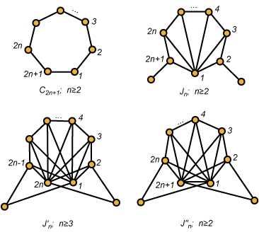
Families of Forbidden Graphs - I

Slide 14
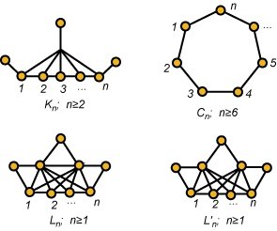
Families of Forbidden Graphs - II

Slide 15
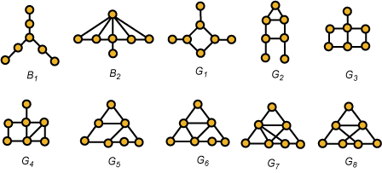
Families of Forbidden Graphs - III

Slide 16
Gallai’s Theorem
Theorem (T. Gallai) A graph G is a comparability graph if and only if it does not contain as an induced subgraph any of the graphs shown in Part I or the complements of any of the graphs shown in Parts II and III.
Remark You are invited to contrast this result with, for example, Kuratowski’s theorem, where by comparison, the number of forbidden structures is infinite but all are based on two simple examples, K₅ and K_{3,3}. Here it is quite an accomplishment that Gallai was able to complete the proof in a finite number of pages.

Slide 17
Characterizing Interval Graphs
Theorem (Fishburn, ‘70) A poset is an interval order if and only if it does not contain the standard example S₂.
Remark It follows then that the minimum list of forbidden subgraphs which characterize interval graphs consists of the complements of those graphs in Gallai’s list C which do not contain an induced cycle C₄ on 4 vertices. This work had actually been completed by Lekkerkerker and Boland prior to the publication of Gallai’s work.

Slide 18
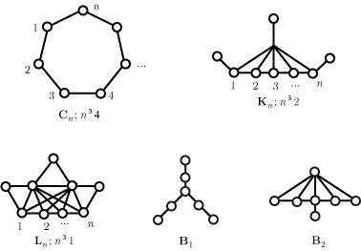
Forbidden Subgraphs for Interval Graphs
Theorem (Lekkerkerker and Boland) A graph G is an interval graph if and only if it does not contain any of the graphs shown below as an induced subgraph.

Slide 19
The List of 3-Irreducible Posets
Remark A poset is 3-irreducible if and only if (1) its complement is one of the graphs in Gallai’s list C, and (2) its comparability graph does not contain one of the graphs in C. So a full listing of all 3-irreducible posets can be determined by systematically examining the graphs in C, an effort which can be completed by hand in a few hours time.

Slide 20
The List of 3-Irreducible Posets
Theorem (Kelly and independently byTrotter and Moore) The full list of all 3-irreducible posets consists of the posets shown on the following two slides.

Slide 21
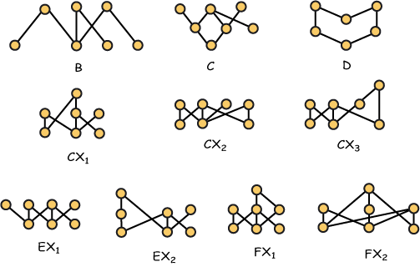
Miscellaneous Examples

Slide 22
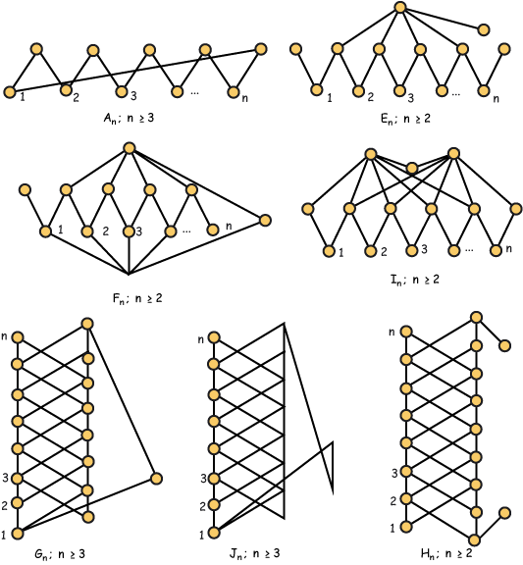
Infinite Families

