Slide 1
Krakow, Summer 2011
Schnyder’s Theorem and Relatives
William T. Trotter
trotter@math.gatech.edu

Slide 2
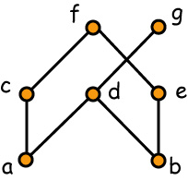
The Dimension of a Poset
L₁ = b < e < a < d < g < c < f
L₂ = a < c < b < d < g < e < f
L₃ = a < c < b < e < f < d < g
The dimension of a poset is the minimum size of a realizer. This realizer shows dim(P) ≤ 3. In fact,
dim(P) = 3

Slide 3
A Modest Question
Question Why should someone whose primary focus is graph theory be at all interested in the subject of dimension for partially ordered sets?

Slide 4
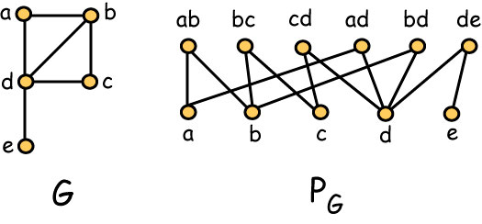
Incidence Posets

Slide 5
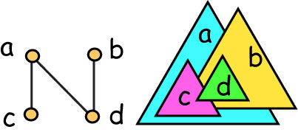
Triangle Orders

Slide 6
Alternate Definition
Exercise A poset has dimension at most 3 if and only if it is a triangle order.

Slide 7
Schnyder’s Theorem
Theorem (Schnyder, 1989) A graph is planar if and only if the dimension of its incidence poset is at most 3.

Slide 8
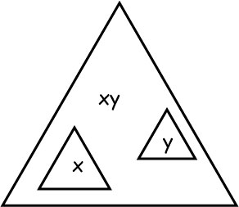
Easy Direction (Babai and Duffus, 1981)
Suppose the incidence poset has dimension at most 3.

Slide 9
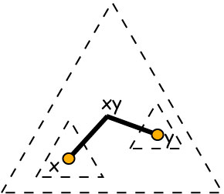
Easy Direction - 2
There are no non-trivial crossings. It follows that G is planar.

Slide 10
Schnyder’s Theorem – The Hard Part
Theorem (Schnyder, 1989) If G is planar, then the dimension of its incidence poset is at most 3.
Without loss of generality, G is maximal planar, i.e., G is a triangulation.

Slide 11
Outline for the Hard Part
Schnyder labelings of rooted planar triangulations.
Uniform angle lemma.
Directed paths witnessing 3-connectivity.
Explicit decomposition of edges into 3 forests.
Inclusion property for regions.
Three auxiliary partial orders.
Linear extensions determine a realizer of P.

Slide 12
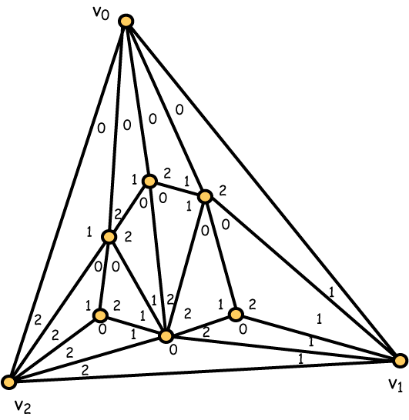
Schnyder Labeling of a Triangulation

Slide 13
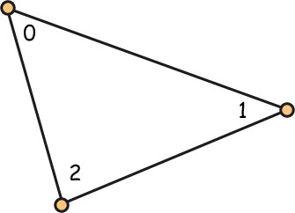
Each interior face
The angles of each interior triangle are labeled in clockwise order 0, 1 and 2.

Slide 14
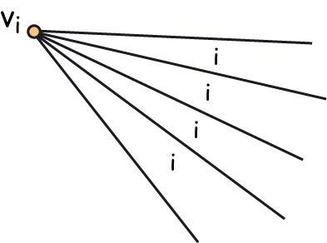
Each Exterior Vertex
For each i = 0, 1, 2, all angles incident with exterior vertex v_{i} are labeled i.

Slide 15
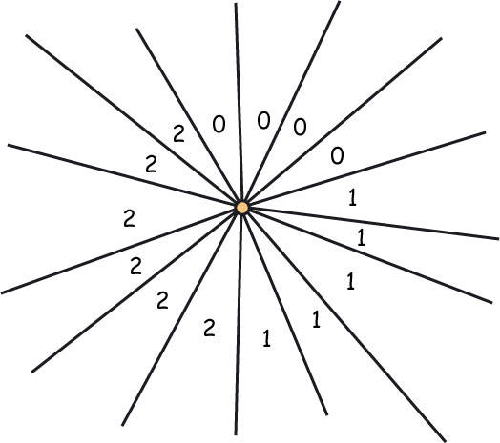
Each Interior Vertex
For each interior vertex x, the angles incident with x are labeled in clockwise order as a non-empty block of 0’s, followed by a non-empty block of 1’s and then a non-empty block of 2’s.

Slide 16
Schnyder Labelings Exist
Lemma Every rooted planar triangulation admits a Schnyder labeling.

Slide 17
Schnyder Labeling of a Triangulation

Slide 18
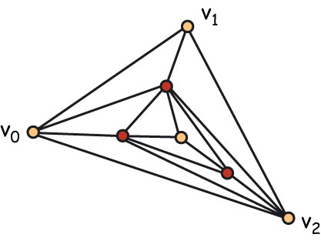
Case 1: Separating Triangle

Slide 19
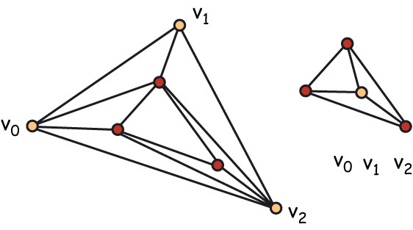
Remove Separating Triangle

Slide 20
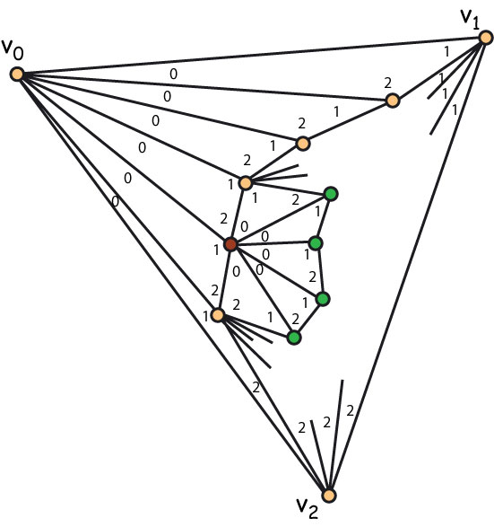
Case 2: No Separating Triangles
The neighbors of v₀ form a path from v₁ to v₂. The only chord on this path is the edge v₁v₂.
Choose a neighbor x of v₀, distinct from v₁ and v₂. Then contract the edge v₀ x

Slide 21
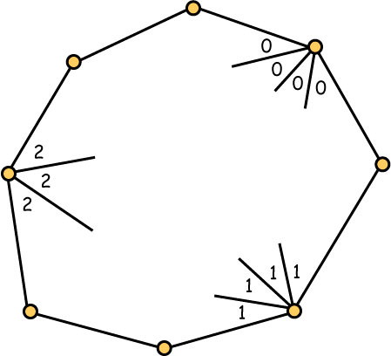
Uniform Angles on a Cycle
Uniform 0
Uniform 2
Uniform 1

Slide 22
Uniform Angle Lemma
Lemma If T is a rooted planar triangulation, C is a cycle in T, and L is a Schnyder labeling of T, then for each i = 0, 1, 2, there is a uniform i on C.

Slide 23
Cycles and Uniform Angles

Slide 24
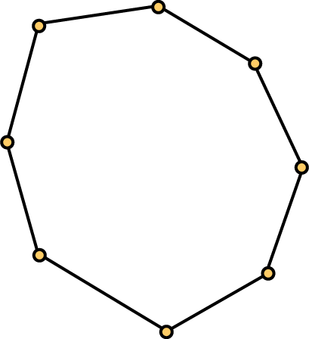
Suppose C has no Uniform 0
Suppose C is the smallest cycle (in terms of the number of enclosed faces) for which there is some i so that C does not contain a uniform i. Without loss of generality, we assume C has no uniform 0.

Slide 25
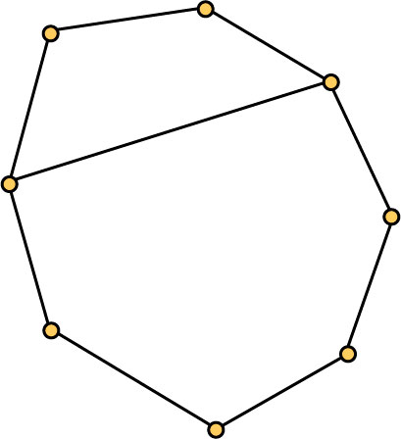
Case 1: C has a Chord
Both the top part and the bottom part have uniform 0’s, so they must occur where the chord cuts the cycle C.

Slide 26
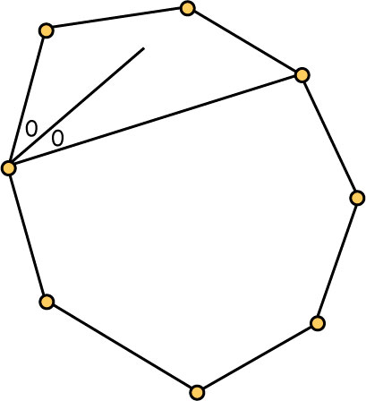
Uniform 0 on Top Part
We assume first that the uniform 0 in the top part occurs in the left corner as shown (the argument is dual in the other case).

Slide 27
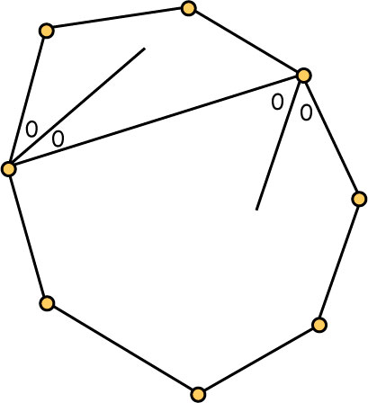
Uniform 0 on Bottom Part
The uniform 0 in the bottom part must then be in the right corner.

Slide 28
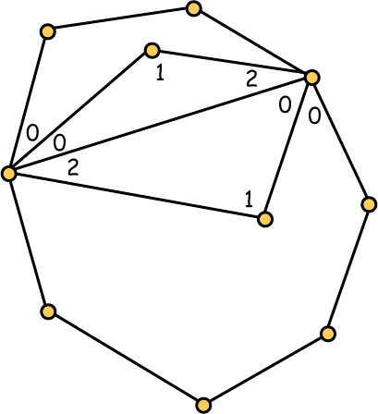
The Contradiction
Consider the two triangle faces that are incident with the chord. Their clockwise labeling results in violations of the consecutive block property at the endpoints of the chord.

Slide 29
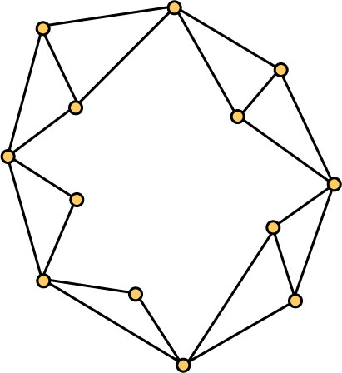
Case 2: C has No Chords
For every edge e = xy on the cycle C, there is a vertex z interior to C so that xyz is a triangle face.

Slide 30
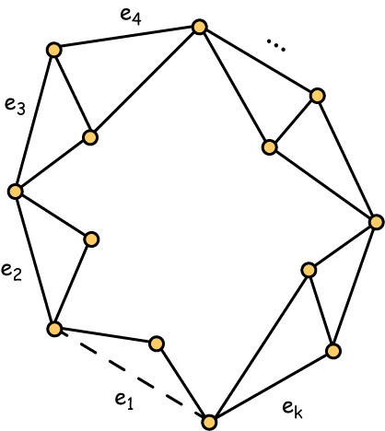
Remove a Boundary Edge
The remaining cycle has fewer faces, so it has a uniform 0. This angle must be incident with the edge that has been removed.

Slide 31
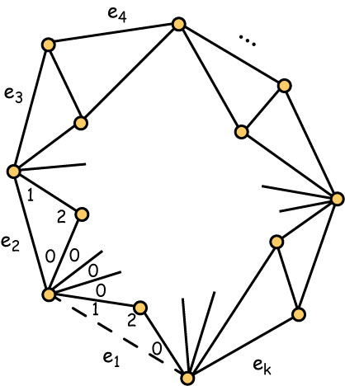
Without Loss of Generality
We assume first that the uniform 0 is on the left, as shown. Again, the other case is dual.

Slide 32
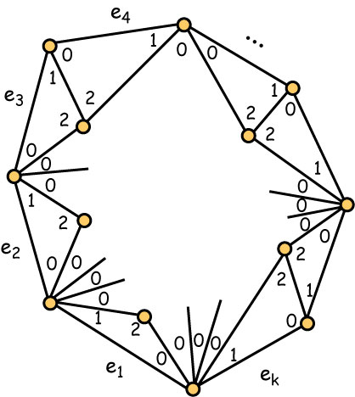
Continue Around Cycle
The argument continues around the cycle until all triangles incident with boundary edges are labeled as shown.

Slide 33
The Contradiction
Now remove any edge from C. The smaller cycle does not have a uniform 2.

Slide 34
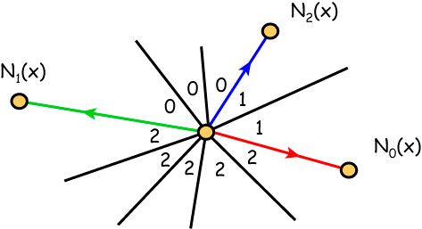
Three Special Edges
Each interior vertex has three special edges leading to distinguished neighbors.

Slide 35
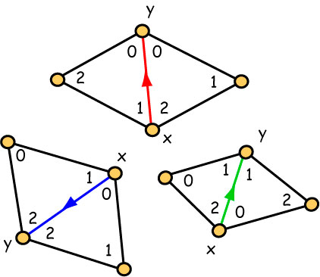
Orienting the Interior Edges
Each interior edge has two common labels on one end and two differing labels on the other. This defines an orientation of all interior edges.

Slide 36
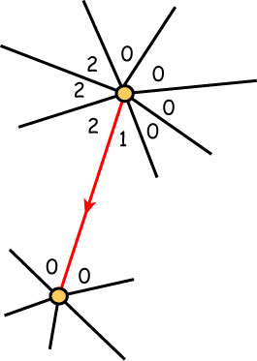
Red Path from an Interior Vertex

Slide 37
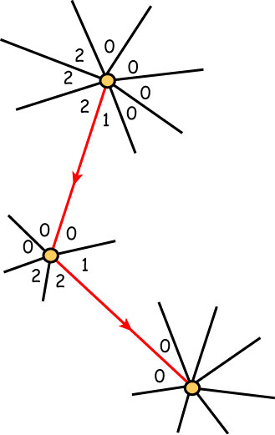
Red Path from an Interior Vertex

Slide 38
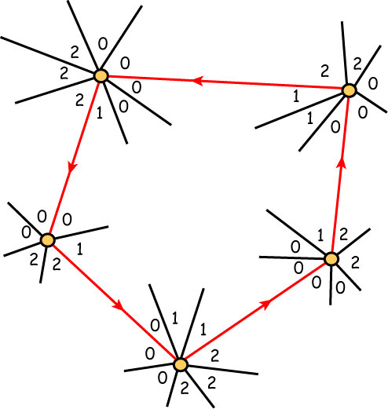
Red Cycle of Interior Vertices??
Such a cycle cannot occur because it would violate the Uniform Angle Lemma.

Slide 39
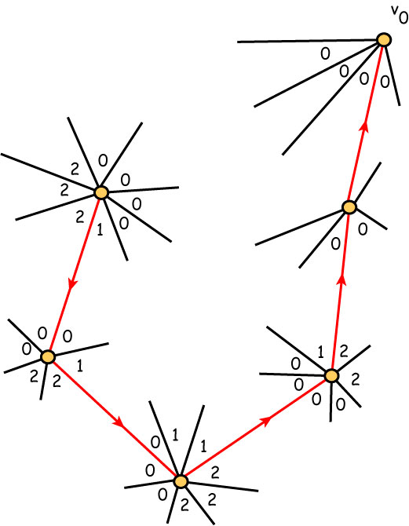
Red Path Ends at Exterior Vertex v₀

Slide 40
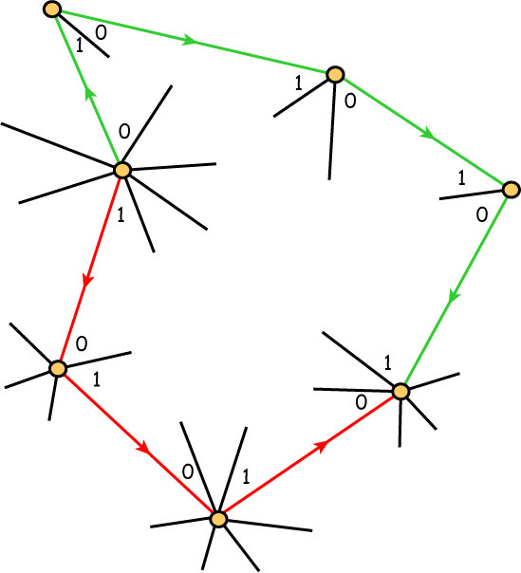
Red and Green Paths Intersect??
Two paths from an interior vertex cannot intersect, as this would again violate the Uniform Angle Lemma.

Slide 41
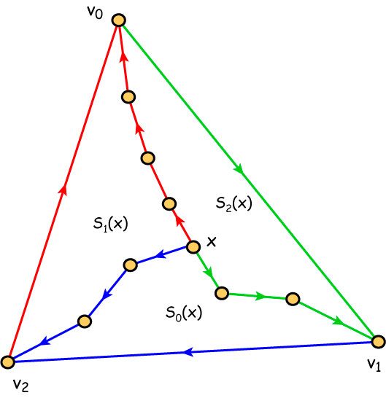
Three Paths and Three Regions
For each interior vertex x, the three pairwise disjoint paths to the exterior vertices determine three regions S₀(x), S₁(x) and S₂(x).

Slide 42
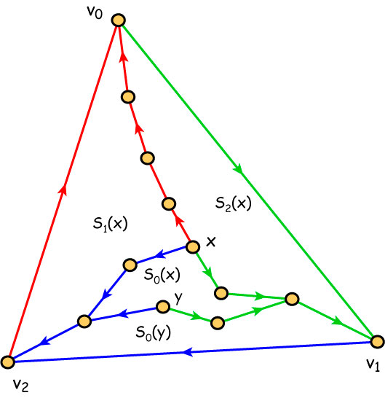
Inclusion Property for Regions
For each i = 0, 1, 2, if y is in S_{i}(x), then S_{i}(y) is contained in S_{i}(x).

Slide 43
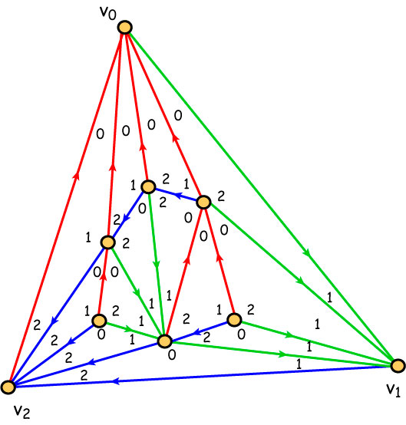
Explicit Partition into 3 Forests

Slide 44
Final Steps
The regions define three inclusion orders on the vertex set.
Take three linear extensions.
Insert the edges as low as possible.
The resulting three linear extensions have the incidence poset as their intersection.
Thus, dim(P) ≤ 3.

Slide 45
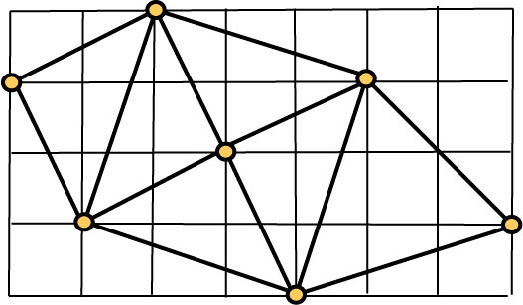
Grid Layouts of Planar Graphs

Slide 46
Labelings Determine Embeddings
Corollary (Schnyder, 1990) For each interior vertex x and each i = 0,1,2, let f_{i} denote the number of faces in region S_{i}(x). Then place vertex x at the grid point (f₁, f₂) to obtain a grid embedding without edge crossings.

Slide 47
The Partial Orders Separate Edges
Lemma The three partial orders “separate” edges. If e = xy and f = zw are edges with no common end points, then there is some i for which either:
x,y > z, w in P_{i} or
z, w > x, y in P_{i}.

Slide 48
Algebraic Structure for Labelings
Theorem (de Mendez, 2001) The family of all Schnyder labelings of a rooted planar triangulation forms a distributive lattice.

Slide 49
3-Connected Planar Graphs
Theorem (Brightwell and Trotter): If G is a planar 3-connected graph and P is the vertex-edge-face poset of G, then dim(P) = 4.
Furthermore, the removal of any vertex or any face from P reduces the dimension to 3.

Slide 50
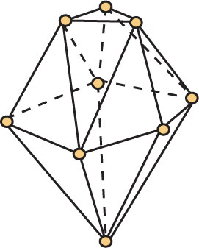
Convex Polytopes in R³

Slide 51
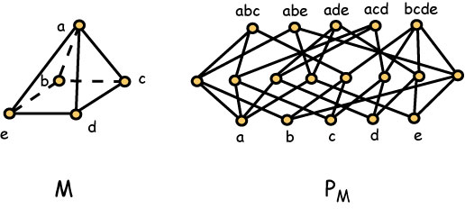
Vertex-Edge-Face Posets

Slide 52
Convex Polytopes in R³
Theorem (Brightwell and Trotter, 1993): If M is a convex polytope in R³ and P is its vertex-edge-face poset, then dim(P) = 4.
Furthermore, the removal of any vertex or face from P reduces the dimension to 3.

Slide 53
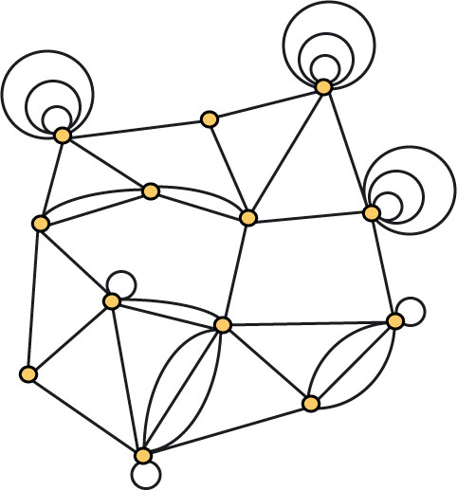
Planar Multigraphs

Slide 54
Planar Multigraphs
Theorem (Brightwell and Trotter, 1993): Let D be a non-crossing drawing of a planar multigraph G, and let P be the vertex-edge-face poset determined by D. Then dim(P) ≤ 4.
Different drawings may determine posets with different dimensions.

