Slide 1
Krakow, Summer 2011
Partially Ordered Sets
Basic Concepts
William T. Trotter
trotter@math.gatech.edu

Slide 2
Formal Definition and Examples
A partially ordered set or poset P is a pair (X, P) where P is an reflexive, antisymmetric and transitive binary relation on X. The set X is called the ground set and members of X are called elements or points. The binary relation P is called a partial order on X.
Example Let X = {1,2,3,4,5,6} and P = {(1,1), (2,2), (3,3), (4,4), (5,5), (6,6), (6,1), (6,4), (1,4), (6,5), (3,4), (6,2). Then P is partial order on X, and (X,P) is a poset.

Slide 3
Natural Examples of Posets
Example Let X be a family of sets and let (A,B) belong to P if and only if A is a subset of B.
Example Let X be a set of positive integers and let (m, n) belong to P if and only if m divides n without remainder.
Example Let X be a set of real numbers and let (x, y) belong to P if and only if x ≤ y in R. In this case, P is a total order (also called a linear order), i.e., for every x, y in X, either (x, y) or (y, x) belongs to P.

Slide 4
Alternative Notation
When R is a binary relation on a set X, we can write x R y as shorthand for (x, y) belongs to R.
With partial orders, it is natural to write x ≤ y in P as a substitute for x P y and (x, y) belongs to P. When the meaning of P is clear, we just write x ≤ y.
Example Let X = {1,2,3,4,5,6} and P = {(1,1), (2,2), (3,3), (4,4), (5,5), (6,6), (6,1), (6,4), (1,4), (6,5), (3,4), (6,2). Then 6 ≤ 5 in P. Note that dropping the reference to P is dangerous when the elements of the ground set are real numbers.

Slide 5
Symbols for Partial Orders
Several other symbols besides ≤ have gained wide spread use in denoting partial orders. Here are two popular examples:
µ and ¹
Of course, the first of these is traditionally used in discussing a family of sets partially ordered by set inclusion.
The notation y ≥ x means the same thing as x ≤ y. Also, we write x < y and y > x when x ≤ y and x ≠ y.

Slide 6
Notation and Terminology
Distinct points x and y are comparable if either x ≤ y in P or y ≤ x in P. Else they are incomparable.
y covers x when x < y in P and there is no z with x < z < y in P. When y covers x, we also say x is covered by y.
x is a minimal point when there is no y with x < y in P.
x is a maximal point when there is no y with x > y in P.

Slide 7
A Concrete Example
Example Let X = {1,2,3,4,5,6} and P = {(1,1),(2,2),(3,3), (4,4), (5,5), (6,6), (6,1), (6,4), (1,4), (6,5), (3,4), (6,2)}.
Then
  6 and 3 are minimal elements.
  2, 4 and 5 are maximal elements.
  4 is comparable to 6.
  2 is incomparable to 3.
  1 covers 6 and 3 is covered by 5.
  4 > 6 but 4 does not cover 6, since 6 < 1 < 4.

Slide 8
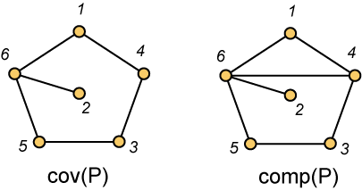
Cover Graphs and Comparability Graphs
There are two graphs associated with a poset P in natural way. Both have as their vertex set the set of elements of P. The cover graph cov(P) has an edge xy when x is covered by y in P. The comparability graph comp(P) has an edge xy when either x < y in P or y < x in P.
X = {1,2,3,4,5,6} and P = {(1,1),(2,2),(3,3), (4,4), (5,5), (6,6), (6,1), (6,4), (1,4), (6,5), (3,4), (6,2)}.

Slide 9
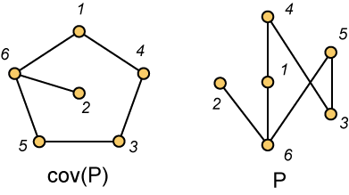
Diagrams of Posets
A drawing (usually with straight lines for edges) of the cover graph of a poset P is called a poset diagram (or just a diagram) for P when the vertical height of y in the plane is higher than the vertical height of x in the plane whenever y covers x in P.
X = {1,2,3,4,5,6} and P = {(1,1),(2,2),(3,3), (4,4), (5,5), (6,6), (6,1), (6,4), (1,4), (6,5), (3,4), (6,2)}.

Slide 10
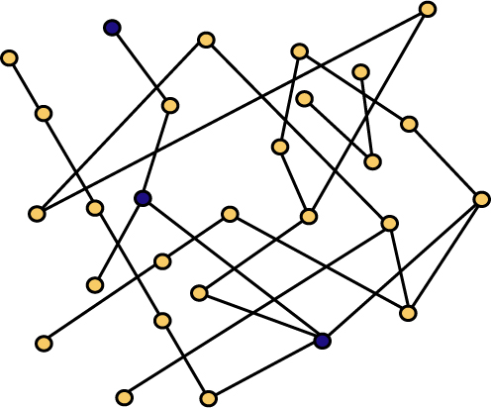
Chains in a Poset
A set C of points in a poset is called a chain if every pair of points in the set is comparable. Here, the blue points are a chain.

Slide 11
Maximal and Maximum Chains
A chain is maximal if it is not a proper subset of another chain. A chain is maximum if no other chain has more points. The cardinality of a maximum chain is the height.

Slide 12
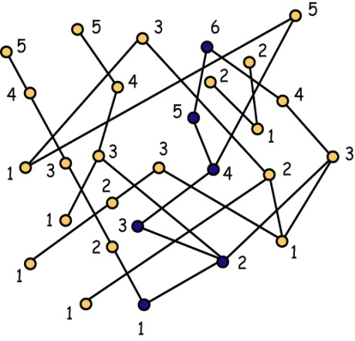
Dual Dilworth – A Folklore Theorem
Theorem A poset of height h can be partitioned into h antichains.

Slide 13
Proof of Dual Dilworth
Proof For each i, let, A_{i} consist of those elements x from P for which the longest chain in P with x as its largest element has i elements. Evidently, each A_{i} is an antichain. Furthermore, the number of non-empty antichains in the resulting partition is just h, the height of P. Also, a chain C of size h can be easily found using back-tracking, starting from any element of A_{h}.
Algorithm A₁ is just the set of minimal elements of P. Thereafter, A_{i+1} is just the set of minimal elements of the poset resulting from the removal of A₁, A₂, …, A_{i}.

Slide 14
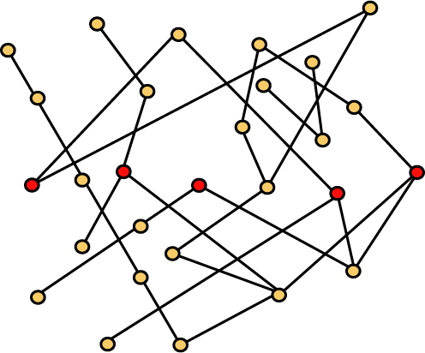
Antichains in a Poset
A set A of points in a poset is called an antichain if every pair of points from the set is incomparable. In this picture, the red points form an antichain.

Slide 15
Maximal and Maximum Antichains
An antichain is maximal if it is not a proper subset of another antichain. An antichain is maximum if no other antichain has more points. The cardinality of a maximum antichain is the width.

Slide 16

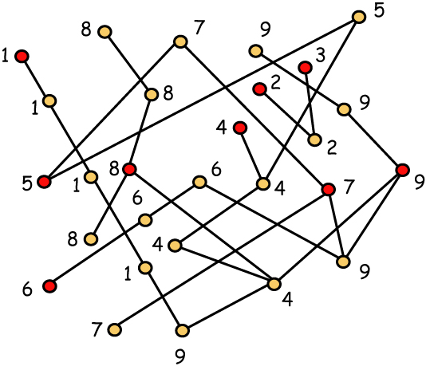
Dilworth’s Theorem (1950)
Theorem A poset of width w can be partitioned into w chains.

Slide 17
The Proof of Dilworth’s Theorem (1)
Proof True when width w = 1 and thus when |P| = 1. Assume valid when |P| ≤ k. Then consider a poset P with |P| = k + 1.
For each maximal antichain A, let D(A) = {x : x < a for some a in A}, and U(A) = {x : x > a for some a in A}. Evidently, P = A ∪ D(A) ∪ U(A) is a partition into pairwise disjoint sets.

Slide 18
The Proof of Dilworth’s Theorem (2)
Case 1. There exists a maximum antichain A with both D(A) and U(A) non-empty.
Label the elements of A as a₁, a₂, …, a_{w}. Then apply the inductive hypothesis to A ∪ D(A), which has at most k points, since U(A) is non-empty. WLOG, we obtain a chain partition C₁, C₂, …, C_{w} of A ∪ D(A) with a_{i} the greatest element of C_{i} for each i = 1, 2, …, w.

Slide 19
The Proof of Dilworth’s Theorem (3)
Then apply the inductive hypothesis to A ∪ U(A). WLOG, we obtain a chain partition C’₁, C’₂, …, C’_{w} with a_{i} the least element of C’_{i} for each i. Then C_{i} ∪ C’_{i} is a chain for each i = 1, 2, …, w and these w chains cover P.
Case 2. For every maximum antichain A, at least one of D(A) and U(A) is empty.
Choose a maximal element y. Then choose a minimal element x with x ≤ y in P. Note that we allow x = y. Regardless, C = {x, y} is a chain – of either one or two points - and the width of P - C is w – 1. Partition P - C into w – 1 chains, and then add chain C to obtain the desired chain partition of P.

Slide 20
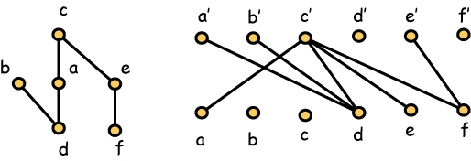
Algorithmic Approach - Fulkerson
Associate with P a bipartite graph with xy’ an edge whenever x < y in P.
Find a maximum matching. For example, use a network flow algorithm.

Slide 21
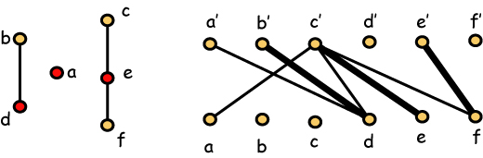
Chain Partition and Width
When xy’ is one of the edges in the maximum matching, x will be covered by y in the chain partition.
Each chain contains a point x where x is reachable but x’ is not. They form an antichain.

Slide 22
Chromatic Number and Clique Size
Definition The maximum clique size of a graph G, denoted ω(G), is the largest integer k for which G contains a clique of size k. The chromatic number of G, denoted χ(G), is the smallest integer t for which the vertices of G can be colored with t colors so that adjacent vertices always receive different colors. Clearly,
χ(G) ≥ ω(G)
for any graph G.

Slide 23
A Classic Result of Erdős
Definition The girth of a graph G is the smallest integer g so that G contains a cycle on g vertices. When the girth of G is 4 or more, the maximum clique size of G is at most 2.
Theorem (Erdős) For every pair g, t of positive integers, there is a graph G so that the girth of G is larger than g and the chromatic number of G is at least t.
In particular, for every integer t, there is a graph G with ω(G) = t and χ(G) > t.

Slide 24
Perfect Graphs
Definition A graph G is perfect when χ(H) = ω(H), for every induced subgraph H of G.
Remark Accordingly, Dilworth’s theorem may be viewed as the assertion that comparability graphs are perfect. Similarly, the dual version just asserts that incomparability graphs are perfect.

Slide 25

Another Proof of Dilworth’s Theorem
Theorem (Lovász) A graph G is perfect if and only if its complement is perfect.
Remark Dilworth’s theorem follows then as an immediate corollary to the trivial dual version on height.

Slide 26
Yet Another Proof of Dilworth’s Theorem
Theorem (Gallai-Millgram) Let G be an oriented graph with indepence number s and let P₁, P₂, …, P_{t} be oriented paths that are pairwise disjoint and cover all vertices of G. Then there is a covering of the vertices of G by pairwise disjoint paths Q₁, Q₂, …, Q_{n} with n ≤ s so that for each i = 1, 2, …, n, if x is the last vertex of Q_{i}, there is some j with 1 ≤ j ≤ t so that x is the last point on P_{j}.

Slide 27
Outline of the Proof
By induction on the number of vertices in G. WLOG, t = s+1. Otherwise, delete one path and apply induction to the subgraph covered by the remaining graph. Now consider the set T consisting of the s+1 terminating points of the paths. This is not an independent set so we may assume that there is an oriented edge from the terminating point x₂ of P₂ to the terminating point x₁ of P₁. The path P₁ cannot be trivial so let u₁ be the predecessor of x₁. Remove x₁ and apply induction. If u1 is used, add x₁. Otherwise, if y₂ is used, again add x₁. If neither is used, then at most s-1 paths are used. Add x₁ as a path.

Slide 28
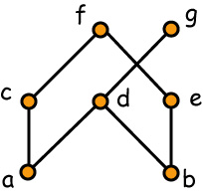
Linear Extensions
Let L be a linear order on the ground set of a poset P. We call L a linear extension of P if x > y in L whenever x > y in P.
Example L₁ and L₂ are linear extensions of the poset P.
L₁ = b < e < a < d < g < c < f
L₂ = a < c < b < d < g < e < f

Slide 29
Realizers of Posets
A family F = {L₁, L₂, …, L_{t}} of linear extensions of P is a realizer of P if P = ∩ F, i.e., whenever x is incomparable to y in P, there is some L_{i} in F with x > y in L_{i}.
L₁ = b < e < a < d < g < c < f
L₂ = a < c < b < d < g < e < f
L₃ = a < c < b < e < f < d < g
L₄ = b < e < a < c < f < d < g
L₅ = a < b < d < g < e < c < f

Slide 30
Every Poset Has a Realizer
Lemma (Szpilrajn) If F is the family of all linear extensions of P, then F is a realizer of P, i.e., whenever x is incomparable to y in P, there is some L in F with x > y in L.
Note This lemma is completely trivial for finite posets.
Definition We say a linear extension L reverses an incomparable pair (x, y) when x > y in L. When P is not a chain, a family F of linear extensions is a realizer of P if and only if for every incomparable pair (x, y), there is some extension L in F so that L reverses (x, y).

Slide 31
The Dimension of a Poset
L₁ = b < e < a < d < g < c < f
L₂ = a < c < b < d < g < e < f
L₃ = a < c < b < e < f < d < g
The dimension of a poset is the minimum size of a realizer. This realizer shows dim(P) ≤ 3. In fact,
dim(P) = 3

Slide 32
Basic Properties of Dimension
Dimension is monotonic, i.e., if P is a subposet of Q, then dim(P) ≤ dim(Q).
dim(P) is the least t so that P is a subposet of the cartesian product of t chains.
dim(P × Q) ≤ dim(P) + dim(Q) for every P and Q.
dim(P^{d}) = dim(P), where P^{d} is the dual of P, i.e., P^{d} has the same ground set as P with x > y in P^{d} if and only if x < y in P.

Slide 33
Three Easy Exercises
Exercise 1. Dimension is “continuous”, i.e., if x is a point in P, then dim(P) ≤ 1 + dim(P – x).
Exercise 2. If x is a minimal element in P, y a maximal element and x is incomparable to y in P, then dim(P) ≤ 1 + dim(P – x- y).
Exercise 3. dim(P × Q) ≤ dim(P) + dim(Q) with equality holding when both P and Q have distinct greatest and least elements.

Slide 34
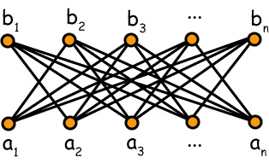
Standard Examples
S_{n}
Fact For n ≥ 2, the standard example S_{n} is a poset of dimension n.
Note If L is a linear extension of S_{n}, there can only be one value of i for which a_{i} > b_{i} in L.

Slide 35
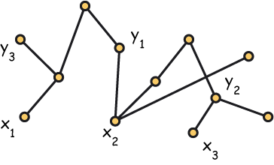
Dimension is a Coloring Problem
Restatement Computing the dimension of a poset is equivalent to finding the chromatic number of a hypergraph whose vertices are the set of all ordered pairs (x, y) where x and y are incomparable in P. Here, no linear extension can reverse (x₁, y₁), (x₂, y₂) and (x₃, y₃).

Slide 36
Testing dim(P) ≤ 2
Fact A poset P satisfies dim(P) ≤ 2 if and only if its incomparability graph is a comparability graph.
Fact Testing a graph on n vertices to determine whether it is a comparability graph can be done in O(n⁴) time.

Slide 37
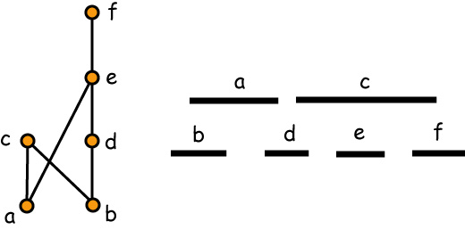
Interval Orders
A poset P is an interval order if there exists a function I assigning to each x in P a closed interval I(x) = [a_{x}, b_{x}] of the real line R so that x < y in P if and only if b_{x} < a_{y} in R.

Slide 38
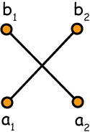
Characterizing Interval Orders
Theorem (Fishburn, ‘70) A poset is an interval order if and only if it does not contain the standard example S₂.
S₂ = 2 + 2

Slide 39
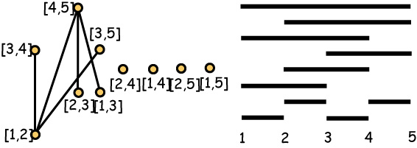
Canonical Interval Orders
The canonical interval order I_{n} consists of all intervals with integer end points from {1, 2, …, n}.
I₅

Slide 40
Dimension of Interval Orders
Theorem (Bogart and Trotter) For every t, there exists an integer n₀ so that if n > n₀, then dim(I_{n}) > t.
Proof Let F be a realizer of I_{n}. For each 3-element set {i < j < k}, choose L from F with [i, j] > [j, k] in L. If n is sufficiently large compared to |F|, it follows from Ramsey’s theorem that there is some 4-element subset H = {i, j, k, l} and some L in F so that all 3-elements of H are associated with L. This requires
[i, j] > [j, k] > [k, l] in L
which is a contradiction since [i, j] < [k, l] in P.

Slide 41
Dimension of Interval Orders
Theorem (Füredi, Rödl, Hajnal and WTT, ‘91) The dimension of the canonical interval order I_{n} is
lg lg n + (1/2 - o(1)) lg lg lg n
Corollary The dimension of an interval order of height h is at most
lg lg h + (1/2 - o(1)) lg lg lg h

Slide 42
Sometime Large Height is Necessary
Observation Posets of height 2 can have arbitrarily large dimension … but among the interval orders, large dimension requires large height.

Slide 43
Dimension of Interval Orders (2)
Note The most important aspect of the preceding theorem is that there exist interval orders of large dimension. In some sense, this is analogous to the statement that there exist triangle-free graphs with large chromatic number, since interval orders do not contain standard examples.

Slide 44
Dimension and Width (1)
Exercise (Hiraguchi) If C is chain in a poset P, then there exists a linear extension L of P with x > y in L whenever x is in C and x is incomparable to y in P.
Corollary (Hiraguchi) dim(P) ≤ width(P), for every poset P.
Proof If w = width(P), use Dilworth’s theorem to find a partition of P into w chains. Then apply the exercise above to each of these chains to obtain a realizer of size w.

Slide 45
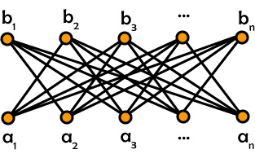
Dimension and Width (2)
Note The inequality dim(P) ≤ width(P) is tight, since dim(S_{n}) = width(S_{n}) = n.

Slide 46
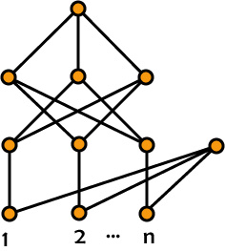
Dimension and Width (3)
Exercise For n ≥ 2, the dimension and the width of this poset is n + 1. When n ≥ 3, it is irreducible, i.e., remove any point and the dimension drops to n.

Slide 47
Dimension and Cardinality (1)
Theorem (Hiraguchi) If |P| ≥ 4, then dim(P) ≤ |P|/2.
Sketch of the proof. It is relatively easy to show that for every poset P with |P| ≥ 5, either
a. There exist x, y in P such that dim(P) ≤ 1 + dim(P – x – y).
There exist x, y, z, w in P such that dim(P) ≤ 2 + dim(P – x – y – z – w).
As a result, it is straightforward to complete the proof by induction on |P|, once the result is known to hold for small values, say |P| ≤ 5.

Slide 48
Dimension and Cardinality (2)
Note The inequality dim(P) ≤ |P|/2 when |P| ≥ 4 is tight, since for all n ≥ 2, dim(S_{n}) = n.

Slide 49
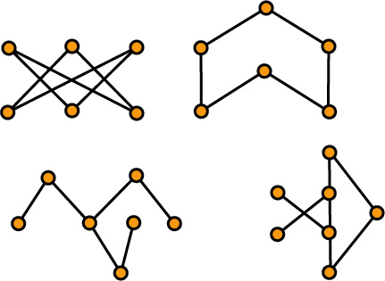
Dimension and Cardinality (3)
Fact These posets are 3-irreducible, i.e., they have dimension 3 and the removal of any point lowers the dimension to 2. The full list of all 3-irreducible posets is known. It consists (up to duality) of 7 infinite families and 10 other examples.

Slide 50
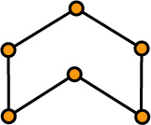
Dimension and Cardinality (4)
Theorem (Bogart and Trotter) If n ≥ 3 and |P| = 2n, then dim(P) < n unless P is S_{n} except when n = 3 and P (or its dual) is the chevron.
Remark Most of the difficulty in proving this theorem comes just with establishing that S₈ is the only 4-irreducible poset on 8 vertices. Once this is done, the full result follows from application of removal theorems.

Slide 51
Dimension and Cardinality (5)
Theorem If n ≥ 4 and |P| ≤ 2n + 1, then dim(P) < n unless P contains S_{n}.
Note The proof of this theorem is very lengthy, and no entirely complete version has ever been written down. Part of the difficulty stems from the fact that it is difficult to show that there are no 4-irreducible posets on 9 points, but even if this is assumed – say on the basis of computer search, the general argument is still complicated.

Slide 52
Complements of Antichains (1)
Theorem (Kimble, Trotter) If A is an antichain in P, then dim(P) ≤ max{2, |P – A|}.
Sketch of the Proof The argument is by induction starting with the case |P - A| = 2. This is a very elementary argument but one that is simplified by the following basic property of dimension.
Lemma Suppose P and Q are posets and that x is a point in P. Form a new poset R by deleting the point x and replacing it by the poset Q, i.e., if u < x in P, then u < y in R for every y in Q (similar statement for v > x). Then dim(R) = max{dim(P), dim(Q)}.

Slide 53
Complements of Antichains (2)
Note Trotter gave a complete “forbidden subposet characterization” of the inequality. When n ≥ 4, there is a family F_{n} consisting of 2n – 1 irreducible posets so that if P is a poset consisting of an antichain A and n other points, then dim(P) < n unless P contains one of the posets from F_{n}. The standard example S_{n} is one of these posets.

Slide 54
Complements of Antichains (3)
Remark We can combine the preceding two inequalities:
a. dim(P) ≤ width(P).
b. If A is an antichain in P, then
dim(P) ≤ max{2, |P-A|}.
to obtain a simple proof of Hiraguchi’s inequality:
c. dim(P) ≤ |P|/2 when |P| ≥ 4.

Slide 55
Removable Pair Conjecture
Conjecture If |P| ≥ 3, then there exist x, y in P such that
dim(P) ≤ 1 + dim(P – x – y).
Note It was also conjectured that the removal of any critical pair decreases dimension by at most 1. This was disproved by Reuter with a poset of dimension 4. Subsequently, Kierstead and WTT constructed counterexamples for every dimension 5 or greater.

Slide 56
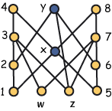
Reuter’s Counterexample
Exercise This poset has dimension 4 and (x, y) is a critical pair whose removal leaves a subposet of dimension 2.

Slide 57
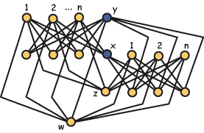
More General Counterexamples
Exercise For every n ≥ 3, this poset has dimension n + 2 and (x, y) is a critical pair whose removal leaves a subposet of dimension n.

Slide 58
Removable Pair Conjecture – Strong Forms
Conjecture If |P| ≥ 3, then for every x, there exists some y distinct from x such that
dim(P) ≤ 1 + dim(P – x – y).
Conjecture If |P| ≥ 3, then there is some critical pair (x, y) in P such that
dim(P) ≤ 1 + dim(P – x – y).

