Slide 1
Krakow, Summer 2011
Circle and Sphere Orders
William T. Trotter
trotter@math.gatech.edu

Slide 2

Families of Disks

Slide 3
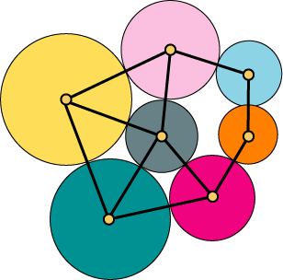
Contact Graphs

Slide 4
A Theorem with Many Proofs
Theorem (Koebe 1936, Andreev 1970, Thurston 1985, and many others) Every planar graph is the contact graph of a family of circular disks in the plane.
Note All known proofs are non-constructive.

Slide 5
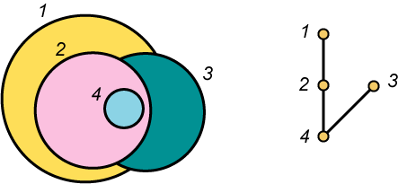
Circle Orders

Slide 6
Circle and Sphere Orders
Question Which posets are circle orders?
Question For each d, which posets can be represented as inclusion orders of d-dimensional spheres?
Conjecture Every 3-dimensional poset is a circle order.

Slide 7
Degrees of Freedom – Informal Discussion
Definition A family F of posets has (at most) k degrees of freedom when it is possible to assign to each element x in a poset in F a sequence x = (x₁, x₂, …, x_{k}) of real numbers so that there is a finite family p₁, p₂, …,p_{r} of polynomials in 2k variables so that the issue of whether x ≤ y in P is determined by the sign pattern of p₁(x,y), p₂(x,y),…, p_{r}(x,y).

Slide 8
Degrees of Freedom – Examples
Examples Interval orders and interval inclusion orders both have two degrees of freedom.
Exercise Circle orders have three degrees of freedom. More generally, spheres in R^{d} have d + 1 degrees of freedom.

Slide 9
Alon and Scheinerman’s Theorem
Theorem (Alon and Scheinerman) For every positive integer k, when n is large relative to k, almost no posets on n points having dimension at least k + 1 have a representation by a family which has only k degrees of freedom.
Remark This theorem is proven by first showing an lower bound on the number of posets on n points having dimension at most k + 1. Then a theorem of Warren is used to establish an upper bound for posets representable with only k degrees of freedom.

Slide 10
Sometimes a Matter of Overkill
Remark By the degrees of freedom argument, when n is large, almost all posets of dimension 4 on n points are not circle orders.
Exercise Show that the 14 element poset obtained by removing the zero and the one from the 4-dimensional subset lattice 2⁴ is not a circle order. This is the reason why Venn diagrams are not a useful tool in discussions of intersections and unions of four sets.

Slide 11
Some Basic Results
Remark Spheres in 1-space are just intervals of R, the set of real numbers. A poset P is the inclusion order of a family of intervals of R if and only if dim(P) ≤ 2.
Observation Since circle orders have 3 degrees of freedom, this makes it seem reasonable that all 3-dimensional posets are circle orders.

Slide 12
Motivating Results
Theorem (Schnyder) A graph G is planar if and only if the dimension of its incidence poset (vertices and edges ordered by inclusion) has dimension at most 3.
Theorem (Brightwell and Scheinerman) A graph G is planar if and only if its incidence poset is a circle order.

Slide 13
More Results for Circle Orders
Exercise Show that for each n, the standard example S_{n} is a circle order.
Theorem (Fishburn) Every interval order is a circle order.

Slide 14
The Answer Should be “Yes”
Exercise Let P be a poset with dim(P) ≤ 3. P should be a circle order because for every n ≥ 3, P can be represented as the inclusion order of regular n - gons in the plane (of variable size but with a fixed orientation). When n is very large, a regular n - gon is essentially just a circle.

Slide 15
The Answer Should be “No”
Theorem (Scheinerman and Weirman) The countably infinite 3-dimensional poset Z × Z × Z is not a circle order.
Theorem (Fon der Flaass) The countably infinite poset 2 × 3 × N is not a sphere order.
Remark These results are for infinite posets. But perhaps it is still true that every finite 3-dimensional poset is a circle order.

Slide 16
The Real Answer
Theorem (Felsner, Fishburn and Trotter)
When n is sufficiently large, the finite 3-dimensional poset n × n × n is not a sphere order.
Remark The integer n in the proof of the preceding theorem is huge, but in fact, the result might hold when n is very reasonable, perhaps even when n < 10.

